Slide 1
Incorporating Active Learning in Foundational Courses
Dan Thompson
Coordinator of Instructional Design, Assessment and Educational Technology
Oklahoma State University Center for Health Sciences

Slide 2
Today’s Objectives
By the end of this session, participants will be able to:
Identify most appropriate times to implement active learning in their course(s)
Teach foundational content utilizing instructional strategies that promote active learning
Appropriately assess students during and after active learning sessions

Slide 3
Introduction
What is active learning?
Why do we do it?
How do we know students are learning information taught using active learning techniques?

Slide 4
Flipped Classroom
Flipped Classroom
Students watch a pre-recorded lecture or complete a reading assignment prior to class
Acquiring the content about which you would typically lecture
Implement active learning activities in class that require students to think at a higher level than they normally would during a lecture-based class

Slide 5
CBL/TBL
Case-based learning
Team-based learning
Students work in groups (4-6 students max!) to complete case or team based tasks
Can be used with introductory material or to reinforce a previously introduced topics

Slide 6
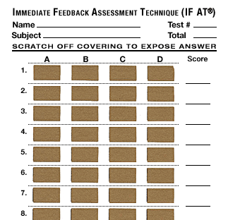
LCMS IRAT/GRAT
Techniques for immediate feedback from students
Individual or group assessments

Slide 7
Peer Review / Bookend
Peer Review
Require students to give feedback on their peers’ submissions
Recommend for use when students are creating original work or answering short answer/essay questions
ExamSoft allows this to happen anonymously
Bookend Procedure
Brief lecture blocks interspersed with group discussion and/or assessments

Slide 8
Important!!
Prepare
Identify what you want students to know (learning objectives!) and structure your activity so that students will need to obtain this information
Organize
Clear and concise
Tell students exactly what you expect of them
When applicable, give this to them in writing (ex. Class handout)
Tell students what they can expect of you

Slide 9
Which Info to Choose
Basic information that most students could have a grasp of by reading or watching a video
Information on which you would typically hold a discussion
In lieu of lecturing, require students to obtain the material by having them complete an assigned task

Slide 10
Pre-Test
At the beginning of a course, ask students the information you need to know to choose which foundational material is most appropriate for active learning
Prerequisite courses taken
Very basic information on a topic

Slide 11
Need for Assessment and Feedback
Students should be assessed to ensure they have learned the material
This allows them to self-assess as well
Feedback is necessary!
Students need to know when they are performing well and when they need to improve
They should receive feedback for each assessment
The first feedback they receive should not be on a high stakes exam

Slide 12
Mini Presentations
In-class
Video
Students create short presentations to share with the class based on information researched in groups
Make sure to recap information and highlight the most important points!
Post a study guide, student PowerPoints, and/or other useful student materials

Slide 13
Articulate 360
Integrates with PowerPoint
Create interactive slide-based presentations
Can post to an LMS or send to students as a link

Slide 14
Thank you!!
Questions/Comments??
Dan.thompson@okstate.edu

